Slide 1
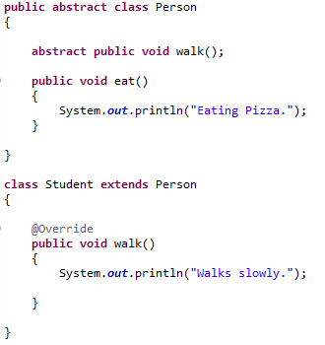
An abstract class is a class that is declared abstract—it may or may not include abstract methods.
Abstract classes cannot be instantiated, but they can be subclassed.
Abstract Methods and Classes
An abstract method is a method that is declared without an implementation (without braces, and followed by a semicolon)
If a class includes abstract methods, then the class itself must be declared abstract
When an abstract class is subclassed, the subclass usually provides implementations for all of the abstract methods in its parent class. However, if it does not, then the subclass must also be declared abstract.
Methods in an interface that are not declared as default or static are implicitly abstract, so the abstract modifier is not used with interface methods. (It can be used, but it is unnecessary.)

